Slide 1


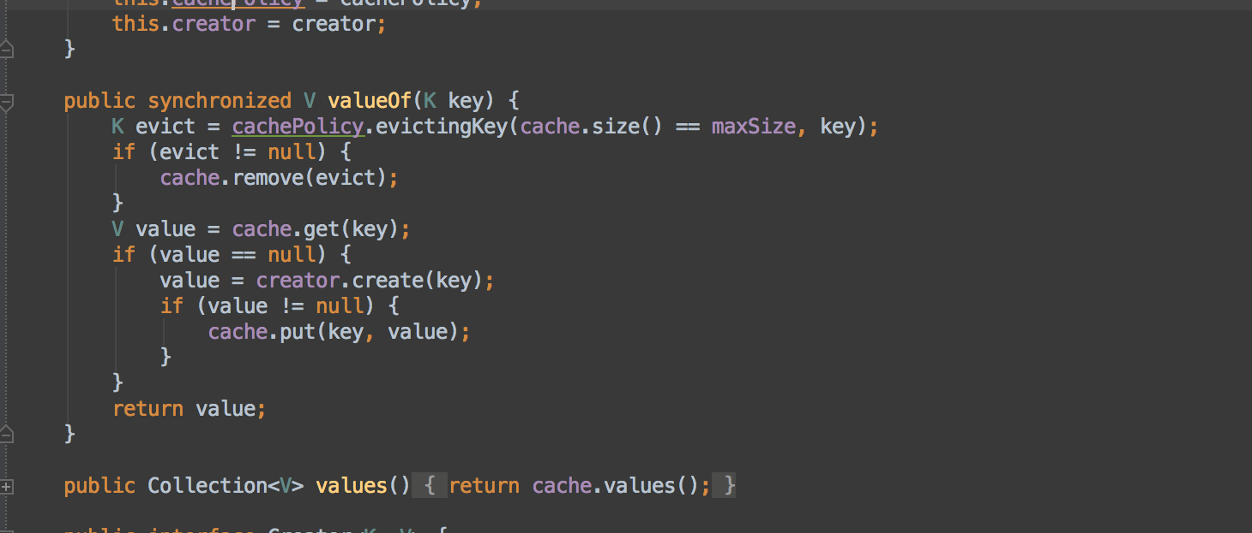


Functional Programming
Lambda Expressions
Advanced
C#
SoftUni Team
Technical Trainers
Software University
http://softuni.bg

Slide 2

Table of Contents
Functional Programming Paradigms
Lambda Expressions
Action<T>, Func<T>
Passing Functions to Methods
λ

Slide 3
Questions
sli.do #5110

Slide 4
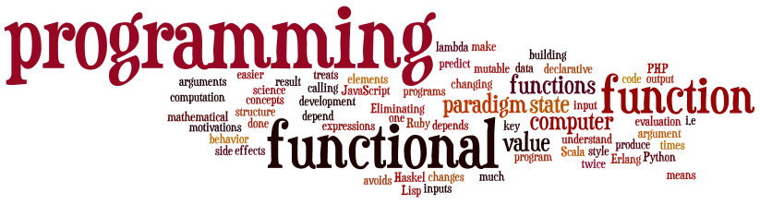
Functional Programming
Paradigms, Concepts
Notes:
Functional programming is a programming paradigm
Uses computations of mathematical functions to build programs
Declarative programming paradigm (not imperative)
Pure-functional languages (no variables and loops): Haskell
Almost-functional: Clojure, Lisp, Scheme, Scala, F#, JavaScript
Imperative with functional support: C#, Python, Ruby, PHP, Java
Non-functional: C, Pascal, the old versions of C#, Java, C++, PHP

Slide 5
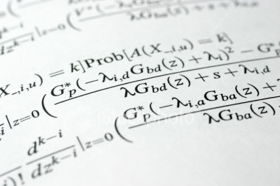
Lambda Expressions

Slide 6
Lambda Expressions
A lambda expression is an anonymous function containing expressions and statements
Used to create delegates or expression tree types
Lambda expressions
Use the lambda operator =>
Read as "goes to"
The left side specifies the input parameters
The right side holds the expression or statement

Slide 7

Lambda Expressions
Examples

Slide 8
Action<T>
In .NET Action<T> is a void method:
Instead of writing the method we can do:
Then we use it like that:
private void Print(string message)
{ Console.WriteLine(message); }
Action<string> print = message => Console.WriteLine(message);
print(“pesho”);
print(5.ToString());

Slide 9
Func<T>
In .NET Func<T, TResult> is a method that returns type TResult
We can use Func<T, TResult>
private int Increment(int number)
{ return number + 1; }
Func<int, int> increment = number => number + 1;
int a = increment(5);
int b = increment(a);

Slide 10
Action<T> and Func<T>
Exercises in class

Slide 11
Passing Functions to Method
We can pass Func<T> to methods:
We can use the method like that:
private int Operation(int number, Func<int, int> operation)
{
return operation(number);
}
int a = 5;
int b = Operation(a, number => number * 5);
int c = Operation(a, number => number – 3);
int d = Operation(b, number => number % 2);

Slide 12
Passing Functions to Method
We can filter collections using Func<T>:
private List<int> Filter(List<int> list, Func<int, bool> filter)
{
List<int> result = new List<int>();
foreach(int number in list)
{
if(filter(number))
result.Add(number);
}
return result;
}
List<int> list = new List<int> {2, 5, -4, -1, 54, 4};
List<int> evenNums = Filter(list, num => num % 2 == 0);

Slide 13
Passing Functions to Method
Exercises in class

Slide 14

Summary
Lambda expressions are anonymous functions used with delegates
Action<T> is a void function
Func<T, TResult> is a function that returns TResult type

Slide 15








Functional Programming
https://softuni.bg/courses/advanced-csharp

Slide 16

License
This course (slides, examples, demos, videos, homework, etc.) is licensed under the "Creative Commons Attribution-NonCommercial-ShareAlike 4.0 International" license
Attribution: this work may contain portions from
"Fundamentals of Computer Programming with C#" book by Svetlin Nakov & Co. under CC-BY-SA license
"OOP" course by Telerik Academy under CC-BY-NC-SA license

Slide 17






Free Trainings @ Software University
Software University Foundation – softuni.org
Software University – High-Quality Education, Profession and Job for Software Developers
softuni.bg
Software University @ Facebook
facebook.com/SoftwareUniversity
Software University @ YouTube
youtube.com/SoftwareUniversity
Software University Forums – forum.softuni.bg

